Slide 1

Case study: Breast cancer
Hypothesis: all variables are equally important to help distinguish the presence of breast cancer
Objectives:
Detection of breast cancer
identifying important features helps rapidly detect breast cancer

Slide 2
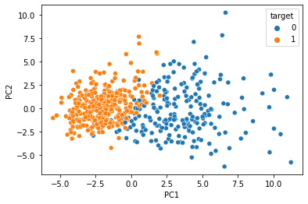
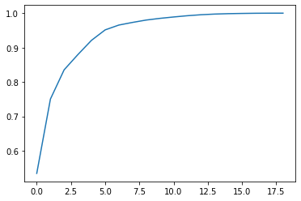
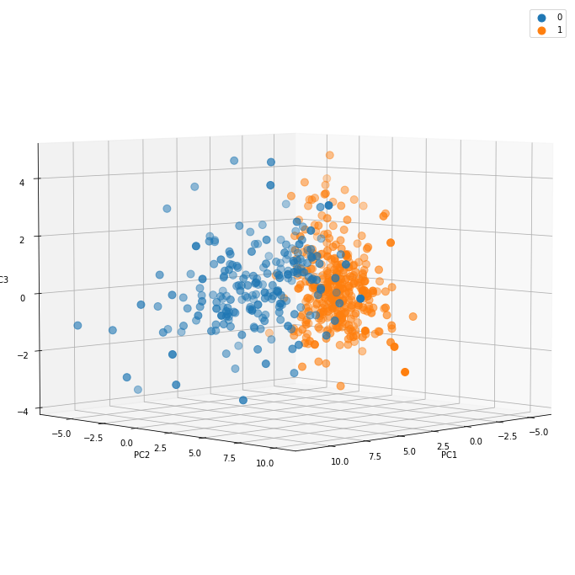
Classification of breast cancer patients (1) from non-breast cancer (0) using Principal component analysis (PCA)
PCA analysis

Slide 3
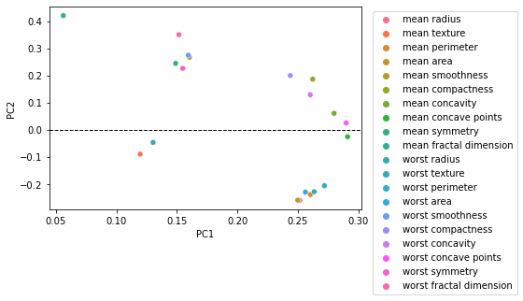
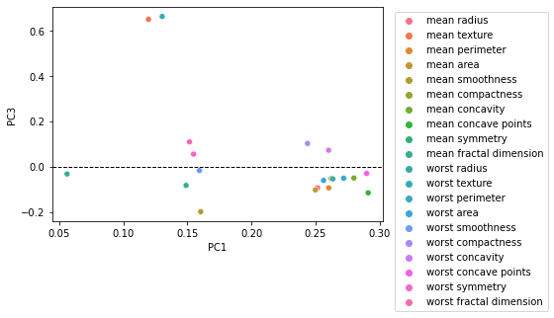
Important variables:
Mean fractal dimension & worst FD
Mean symmetry & worst symmetry
Mean area & worst area
Mean smoothness worst smoothness
Mean perimeter & worst perimeter
Mean texture & worst texture
Important variables:
Mean fractal dimension & worst FD
Mean symmetry & worst symmetry
Mean area & worst area
Mean smoothness worst smoothness
Mean perimeter & worst perimeter
Mean texture & worst texture

Slide 4
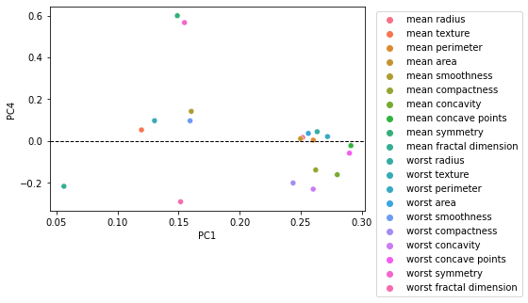
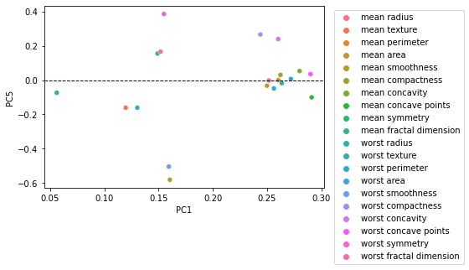
Important variables:
Mean fractal dimension & worst FD
Mean symmetry & worst symmetry
Mean area & worst area
Mean smoothness worst smoothness
Mean perimeter & worst perimeter
Mean texture & worst texture
Important variables:
Mean fractal dimension & worst FD
Mean symmetry & worst symmetry
Mean area & worst area
Mean smoothness worst smoothness
Mean perimeter & worst perimeter
Mean texture & worst texture

Slide 5
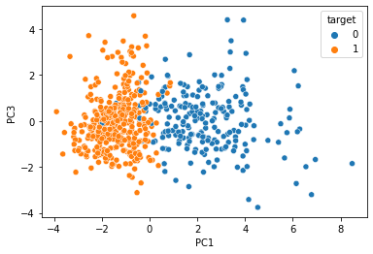
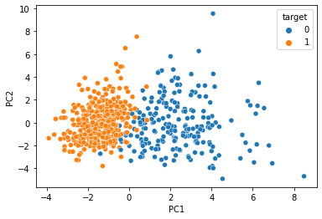
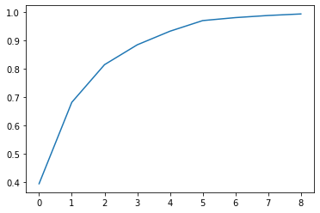
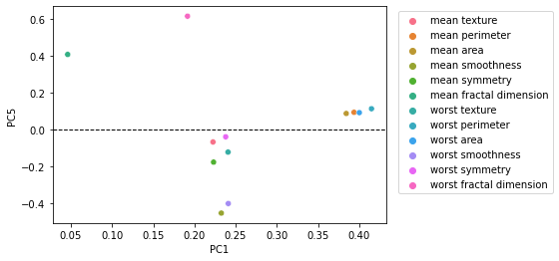
PCA analysis: after dropping 8 variables

Slide 6
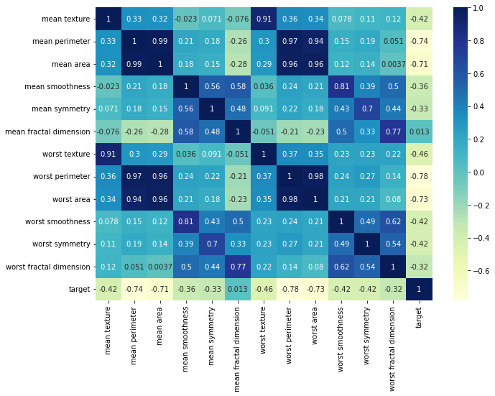
Correlation heatmap between important variables

Slide 7
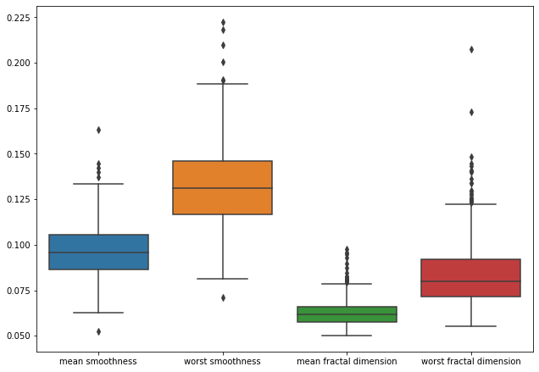
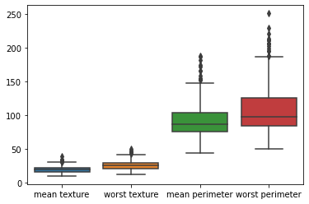
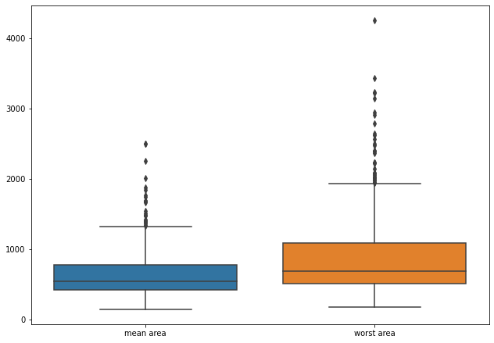
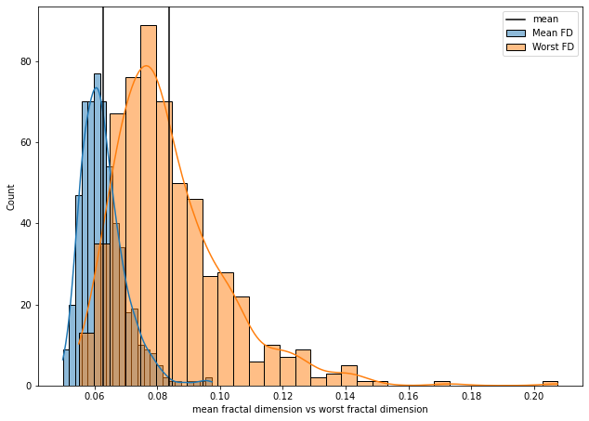

Slide 8
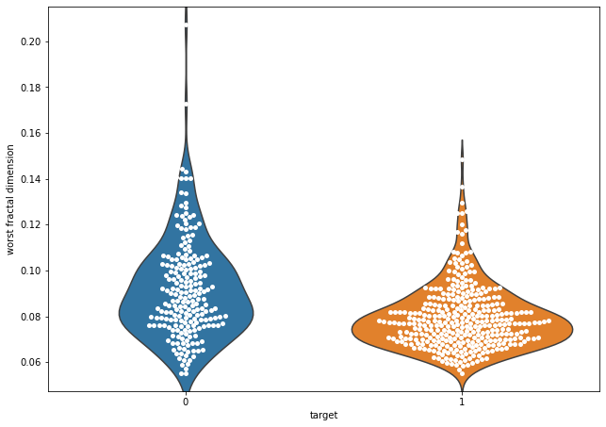
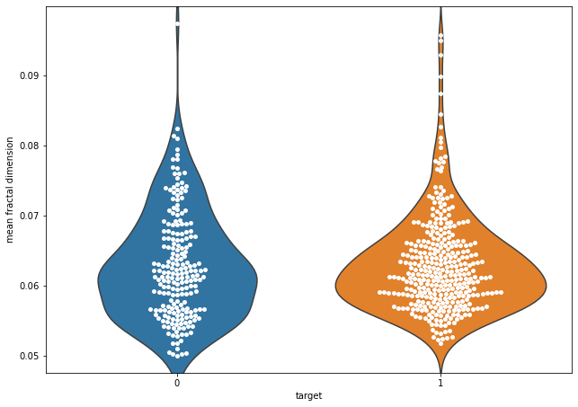
Observe the most important feature using violin and swamp distribution plot

